Slide 1

SAP BTP ABAP on Cloud / RAP Training
DAY-7
Anubhav Oberoy
www.AnubhavTrainings.com
Follow excellence with sheer passion

Slide 2


DISCLAIMER
The training content and delivery of this presentation is confidential, and cannot be recorded, or copied and distributed to any third party, without the written consent of Anubhav Trainings

Slide 3

Understanding BDEF in detail
01
02
Compiler fields
03
Entity Manipulation Language
04
EML Code
Notes:
https://pixabay.com/photos/san-francisco-transamerica-pyramid-1633203/

Slide 4
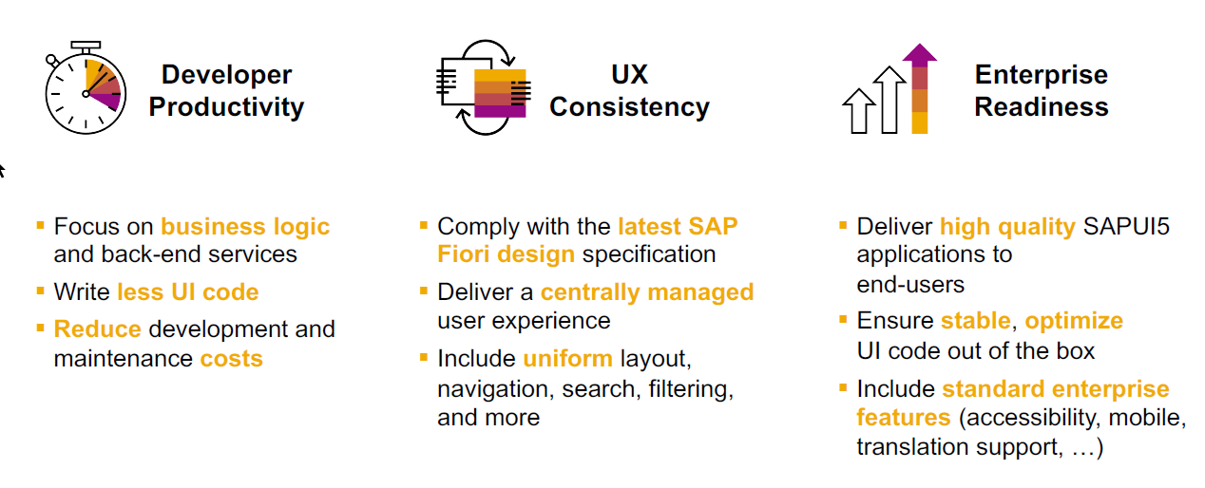
SAP Fiori elements boosts SAP Fiori development efficiency
www.anubhavtrainings.com

Slide 5
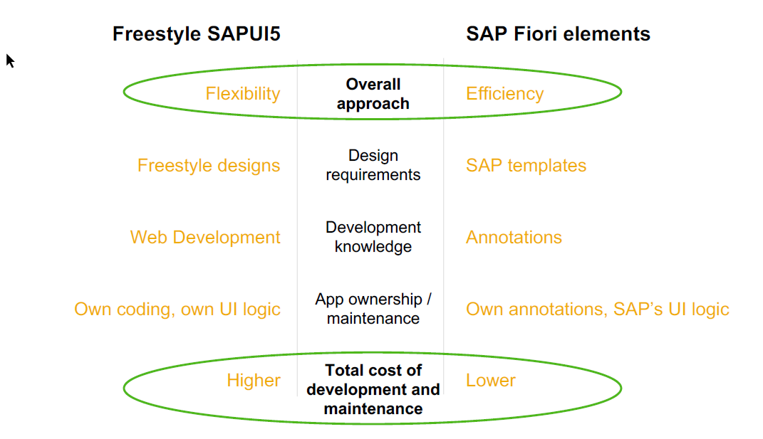
SAP Fiori elements prioritizes efficiency over flexibility
www.anubhavtrainings.com

Slide 6


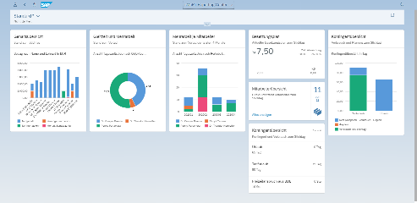





Developer Persona – Fiori Elements
Anubhav
Happy User
Rob
S/4HANA Technical consultant
ABAP Developer
Roxana
UX Designer | Fiori Developer
ABAP Dev. Tools
On
Eclipse
VS Code
BAS
OData Service
Fiori Elements Project
Annotations.xml
CDS Views
MDE
@
www.anubhavtrainings.com

Slide 7
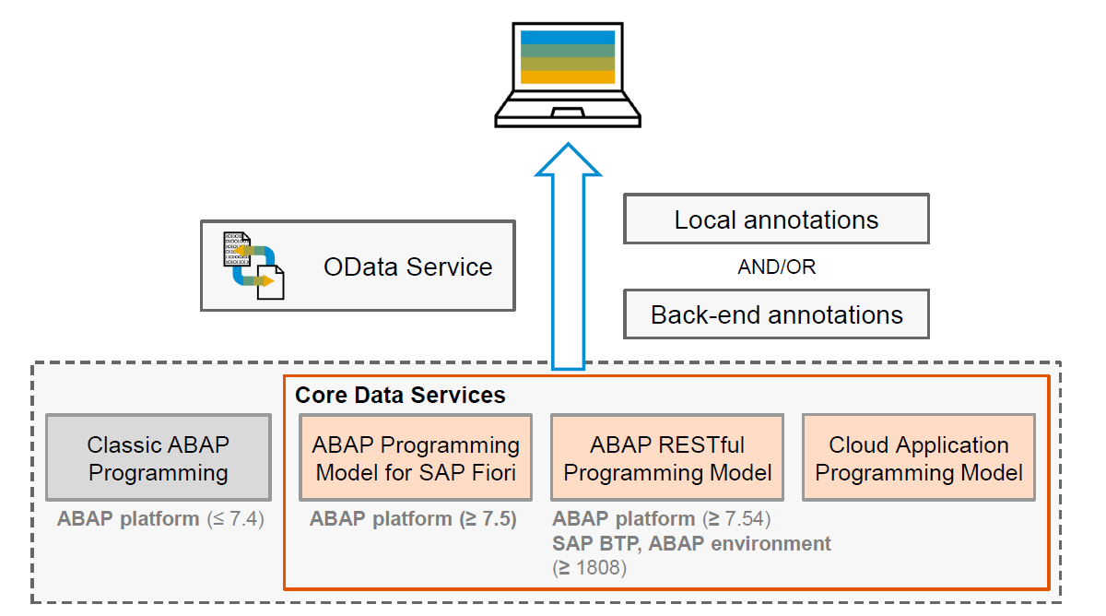
Big Picture – Architecture
www.anubhavtrainings.com

Slide 8
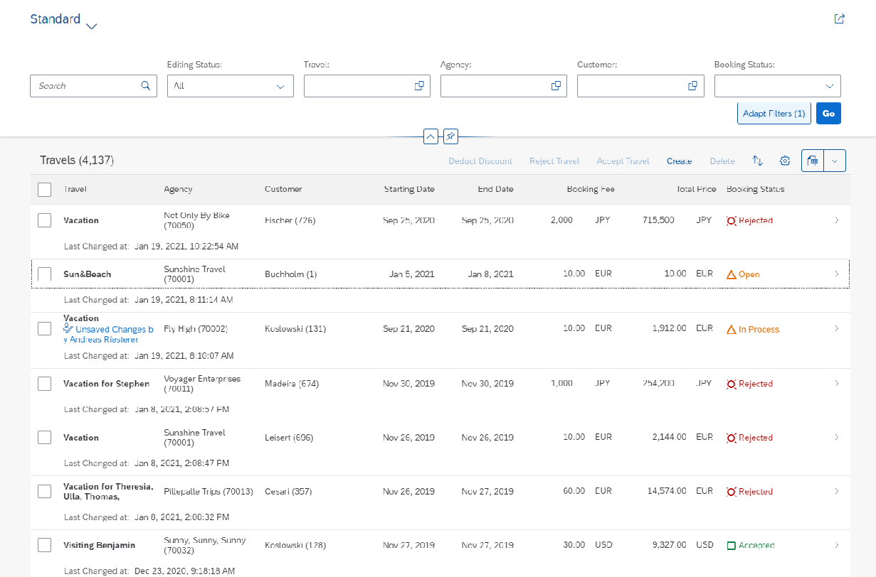
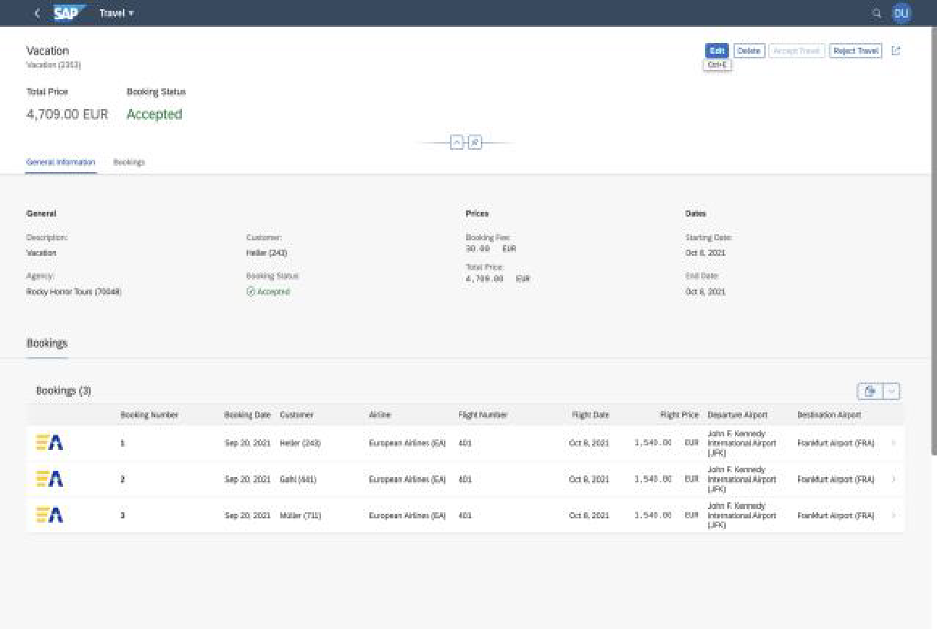
Fiori Elements - List Report Application
The list report offers powerful features for finding and acting on relevant data sets. It is often used as an entry point for navigating to the item details, which are usually shown on an object page.
List Report
Object Page
www.anubhavtrainings.com

Slide 9
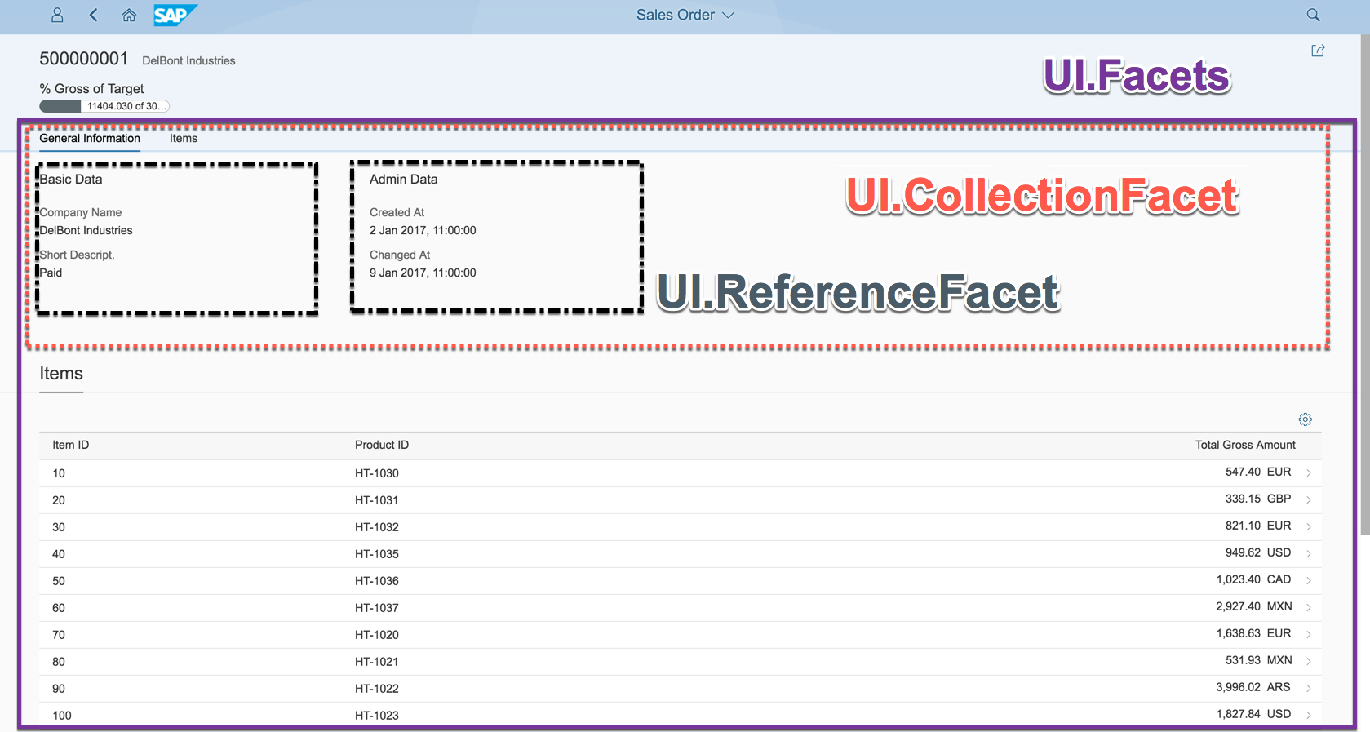

Object Page
www.anubhavtrainings.com

Slide 10
Fiori Elements - List Report Application
The list report offers powerful features for finding and acting on relevant data sets. It is often used as an entry point for navigating to the item details, which are usually shown on an object page.
List Report
Object Page
www.anubhavtrainings.com

Slide 11

Development Flow – Processor and Approver
Fiori App – Processor
Create, update, delete, copy travel
Fiori App – Approver
Display the travel request data
Service definition
Service Binding
Service definition
Service Binding
MDE for Processor Projection
MDE for approver Projection
BDEF Projection
For Processor
Expose what is needed by a processor role in company
Behavior Definition (BDEF)
Tell RAP framework regarding our operations which needs to be supported for BO (managed)
BDEF Projection
For Approver
Expose what is needed by a approver role in company
Business Object Projection
For Processor
30 fields to internet
Business Object (definition)
Includes the Travel, Booking and Booking Supplement CDS entities
100 fields
Business Object Projection
For Approver
25 fields
www.anubhavtrainings.com

Slide 12


Slide 13


Object Page
www.anubhavtrainings.com

Slide 14
Annotation Documentation
https://help.sap.com/doc/saphelp_nw75/7.5.5/en-US/63/0ce9b386b84e80bfade96779fbaeec/content.htm?no_cache=true
https://ui5.sap.com/#/topic/1cf5c7f5b81c4cb3ba98fd14314d4504
@UI.SelectionField – Create filter fields on screen 1 (List Report)
@UI.LineItem – Create Columns on first Screen (Table area on list report)
@UI.HeaderInfo – Provide title to the table and arrange header for the object page (second screen)
@UI.Facets – To create tabs on the object page
@UI.Identification – can only be one, Configure default fields on object page (inside facet)
@UI.FieldGroup – To create field groups (group of fields) in a block with label and text
@UI.datapoint – to create a single value to be displayed in a chart or on top of page
@UI.Chart – to create a chart with a particular chart type
www.anubhavtrainings.com

Slide 15

Exercise
Assign the booking Supplement ID automatically during creation with early numbering.
www.anubhavtrainings.com

Slide 16
www.anubhavtrainings.com
Thank You
End of Day 7
www.anubhavtrainings.com

Slide 17


We’re committed to empower you to be
#FutureReady
through powerful training solutions.
We build the workforce of the future.
250+
Corporate Clients
30,000+
Learners Trained
25000+
Learners Placed
FREE WEBINARS
Sign up for free webinars with industry experts every fortnight!
Enroll Now!
Contact us today!
https://anubhavtrainings.com

